Slide 1
Applications of AI in Banking
Naveen Kumar a s
Ramana j s

Slide 2
Applications of AI in Banking
Customer Service and Virtual Assistants
Fraud Detection and Prevention
Risk Assessment and Compliance
Chatbots and Personalized Banking
Cybersecurity and Threat Detection
Enhanced Data Analytics and Insights

Slide 3
Customer Service and Virtual Assistants
24/7 Availability
Self-Service Capabilities
Scalability and Cost Savings
Fraud Detection and Prevention
Real-time Monitoring and Alerts
Signature Identification and Verification
Pattern Recognition and Link Analysis
Risk Assessment and Compliance
Chatbots and Personalized Banking
Cybersecurity and Threat Detection
Enhanced Data Analytics and Insights

Slide 4
Customer Service and Virtual Assistants
Fraud Detection and Prevention
Risk Assessment and Compliance
Data Analysis and Pattern Recognition
Real-time Monitoring and Early Detection
Efficiency and Cost Savings
Chatbots and Personalized Banking
24/7 Customer Support
Automated Customer Interactions
Natural Language Understanding and Contextual Conversations
Cybersecurity and Threat Detection
Enhanced Data Analytics and Insights

Slide 5
Customer Service and Virtual Assistants
Fraud Detection and Prevention
Risk Assessment and Compliance
Chatbots and Personalized Banking
Cybersecurity and Threat Detection
Real-time Threat Monitoring
Fraud Prevention and Transaction Monitoring
Endpoint Protection and User Authentication
Enhanced Data Analytics and Insights
Advanced Data Processing
Customer Segmentation and Personalization
Risk Management and Fraud Detection

Slide 6
Customer Service and Virtual Assistants
Fraud Detection and Prevention
Identification
Verification
Signature Identification and Verification
Account Opening and Transactions
Check Payments
Loan Applications
Account Access
Legal Documents
Credit Card Transactions
Identity Verification
Forgery Detection
Dispute Resolution

Slide 7
About the Dataset
Signature Identification and Verification
Identification
Verification
Identifying the individual to whom a given signature belongs to.
We proposed an Identifier model for signature identification.
Identifier model works based on Multi Layer Perceptron (MLP)
Verifying weather the signature is genuine or forged
We proposed an Verifier model for signature verification.
Verifier model works based on Multi Layer Perceptron (MLP)

Slide 8
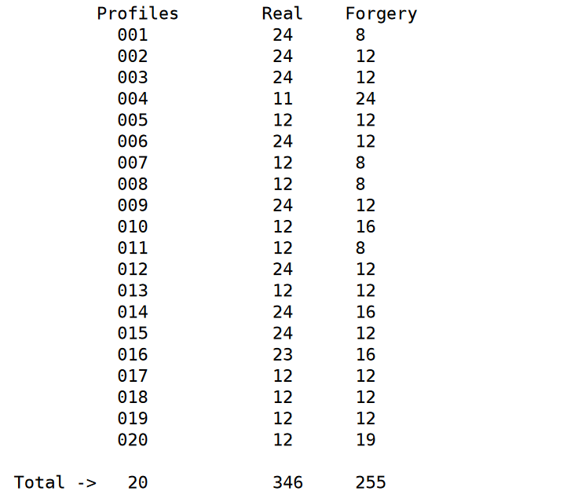
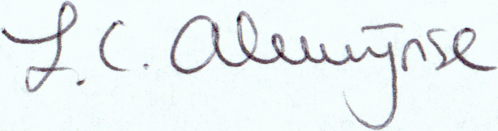
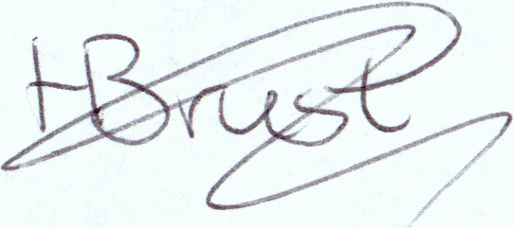
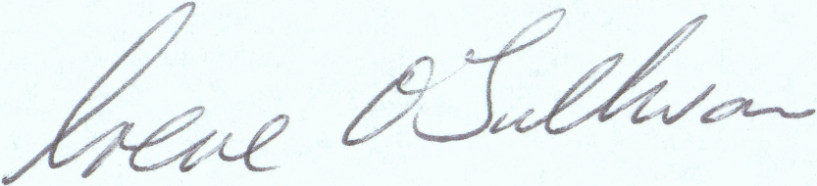
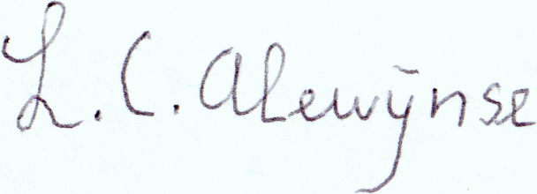
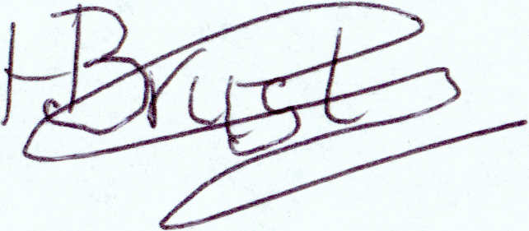
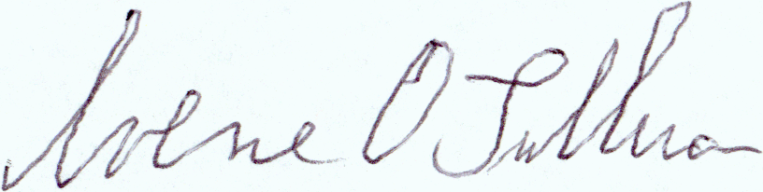
Image Pre-Processing
About the Dataset
The dataset consists images of real and forged signatures of 20 individuals present in a zip file each class being separated by the folder name
In total there are 600+ image of signatures in the dataset
Real >
Forged >

Slide 9
Image Pre-Processing
AUGUMENTATION : Applying modifications like rotation or flipping to increase dataset diversity for training machine learning models
R ESIZING : Adjusting image dimensions to a specific size
NORMALIZATION : Scaling pixel values to a standard range for consistent model training (between 0 and 1)
FLATTENING : Converting a multi-dimensional image array into a one-dimensional vector for input to a neural network.
About the Dataset

Slide 10
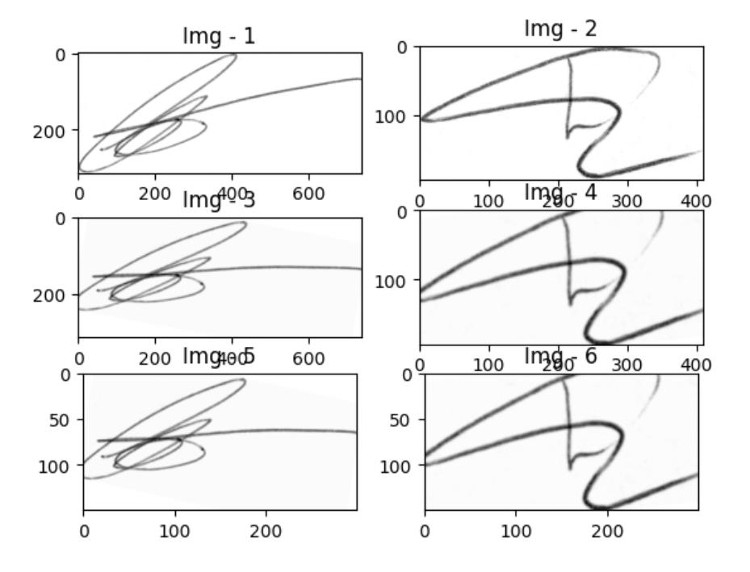
MLP
Image Pre-Processing
Original >
Augmented >
Resized >
About the Dataset

Slide 11
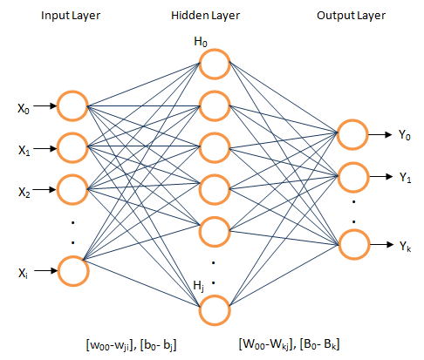
Identifier Model
MLP
MLP (Multi Layer Perceptron) Architecture is used to build both the Identifier and Verifier model
Normalized image is flattened and fed into the input layer of MLP and passes though hidden layer(s) and reaches output layer where the nature of the image can be identified
Image Pre-Processing

Slide 12
Verifier Model
Identifier Model
The Identifier Model's primary function is to classify a given signature into one of the 20 predefined classes, each corresponding to an individual.
This is achieved through a multi-layer perceptron (MLP) architecture, which is trained on the dataset of genuine and forged signatures.
The MLP model comprises multiple layers of interconnected neurons, each layer responsible for extracting specific features from the input signature image.
The output layer provides the classification result, indicating the identity of the signatory.
MLP

Slide 13
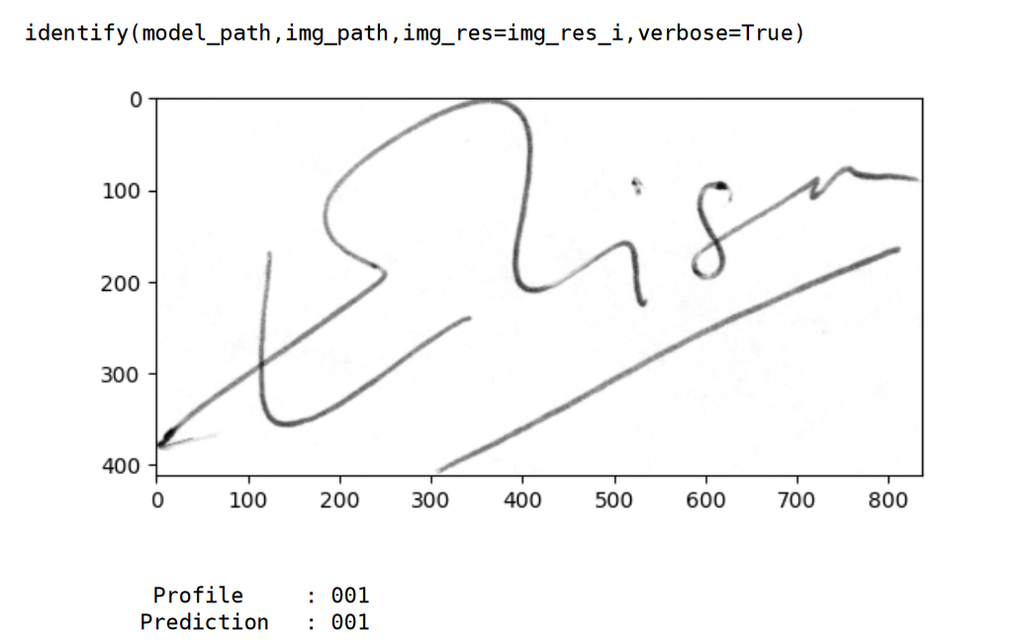
Identifier Model
MLP

Slide 14
Verifier Model
The Verifier Model operates as a binary classifier, categorizing signatures into genuine or forged.
This model employs a Multi-Layer Perceptron (MLP), which serves as the foundation for its architecture.
The input signatures are preprocessed, followed by feature extraction to capture distinctive patterns.
Subsequent fully connected layers are utilized for classification, ultimately determining the authenticity of the provided signature.
MLP
Identifier Model

Slide 15
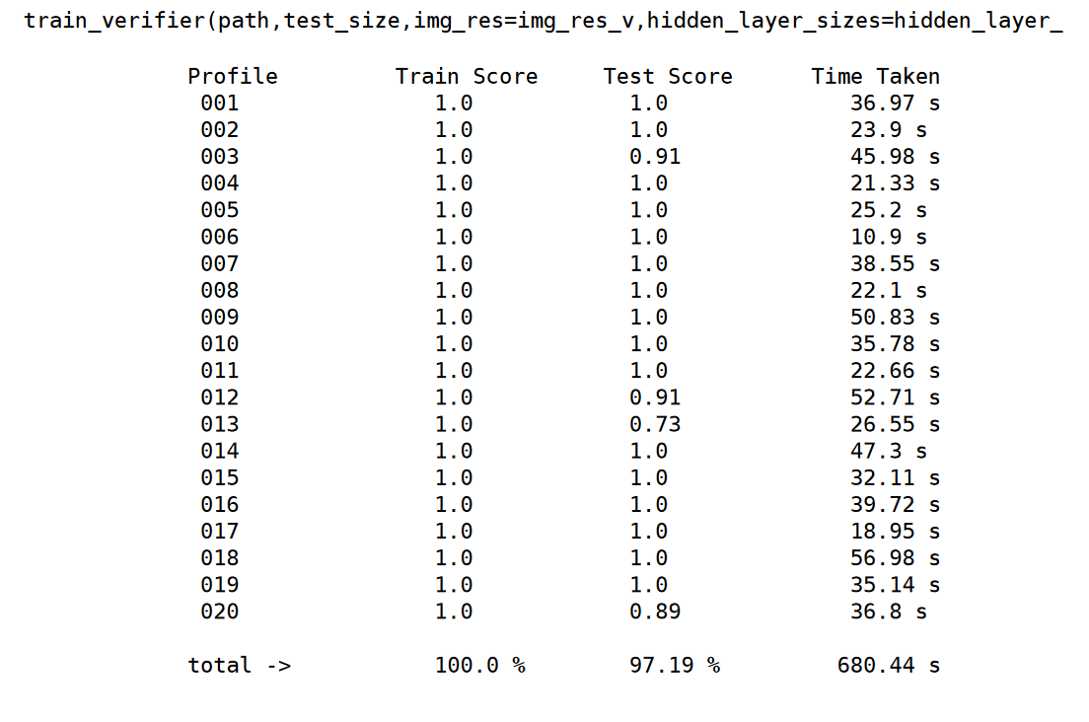
Verifier Model
Each profile has a well trained Verifier model to accurately identify genuine and forged signatures
MLP

Slide 16
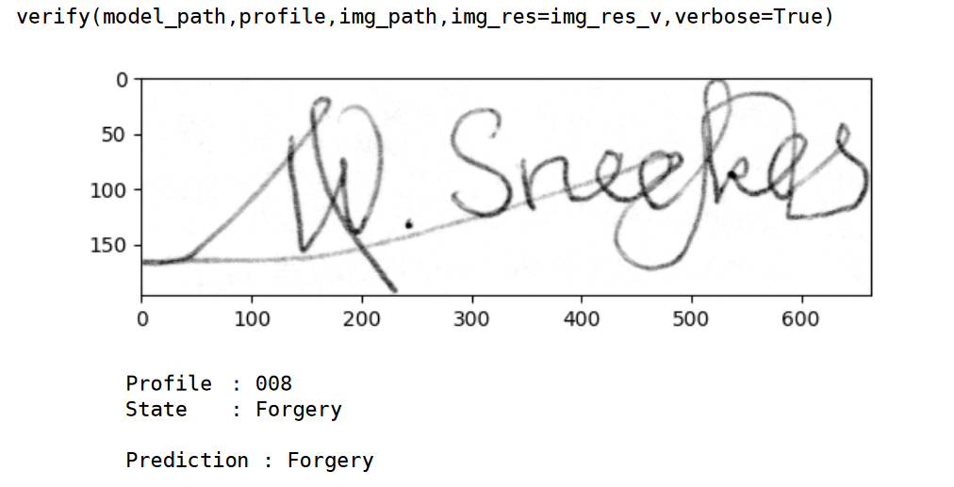
Combining the Models
Verifier Model
MLP

Slide 17
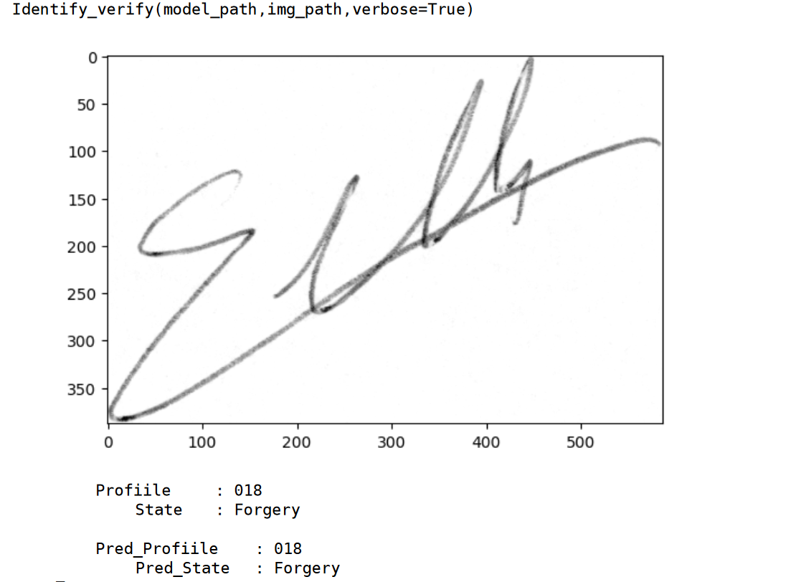
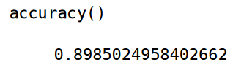
Combining the Models
By combination of both Identifier and Verifier model, a signature is first identified to whom it belongs and with that information, it checked it the respective Verifier model to determine weather the signature is authentic or not.
THANK
YOU
it can able to identify and verify the signature with an accuracy of about 90%.
Verifier Model

Slide 18
THANK
YOU
Combining the Models

